Slide 1
MODULE IV
MULTIPROCESSOR ARCHITECTURE
AND
PROGRAMMING

Slide 2
Multiprocessor System
Multiprocessor is a single computer that includes multiple processors & these processors may communicate with each other in solving a given problem.
A multiprocessor system is controlled by one OS which provides interaction b/w processors & their programs
2 different architectural models of a multiprocessor system are
: Tightly coupled multiprocessor
: Loosely coupled multiprocessor

Slide 3
Loosely coupled multiprocessor system

Slide 4
Loosely coupled multiprocessor
A collection of relatively autonomous system, each CPU having its own main memory and I/O channels.
Each processor has a set of I/O devices & a large local memory, where it accesses most of the data & instructions
The processor, local memory & I/O interfaces are collectively known as a Computer Module
Processes which execute on different computer modules communicate by exchanging messages through a message-transfer system (MTS)
Degree of coupling is very loose in such a s/m, hence referred to as distributed system

Slide 5
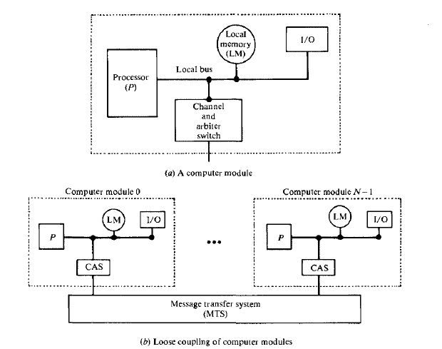

Slide 6
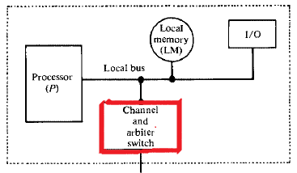
A computer module(CM) consists of a processor, a local memory, local I/O devices & an interface to other computer modules
The interface may contain a channel and arbiter switch (CAS)
The channel within CAS may have high speed communication memory which is used for buffering block transfer of messages.

Slide 7
If requests from 2 or more different CM’s collide in accessing a physical segment of the MTS, the arbiter is responsible for choosing one of the requests
MTS is one of the most important factors that determine the performance of multiprocessor s/m
MTS for a LCS(loosely configured s/m) could be a single time shared bus, where the performance is limited by message arrival rate on bus, msg length, bus capacity etc

Slide 8
Communication b/w processes in a multiprocessor environment
Processes (tasks) can communicate with other processes allocated to same processor, or with tasks allocated to other processors.
Every message issued by the task is directed to the input port of the destination task.
Communication b/w tasks allocated to same processor takes place through local memory only
Communication b/w tasks allocated to different processors is through a communication port residing in communication memory

Slide 9
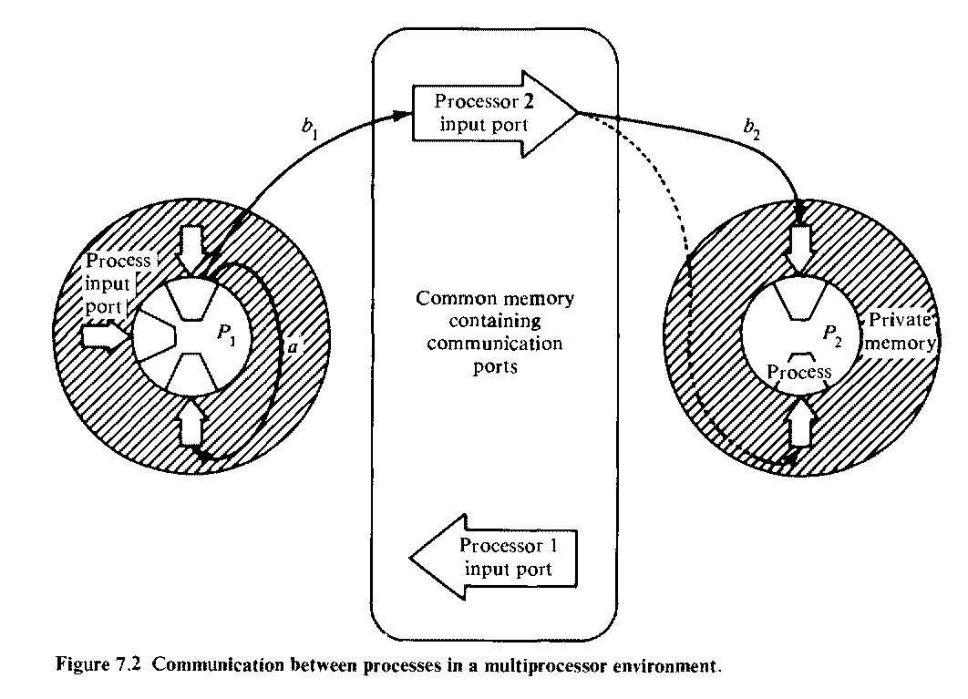

Slide 10
A process allocated to P₁ puts a message into input port of another task in P₁ (arrow marked with a)
b arrow shows a two-step action in transferring messages b/w processors
_{b1} sends a message to the input port of processor P₂
_{b2} shows the moving of message to the input port of destination process

Slide 11
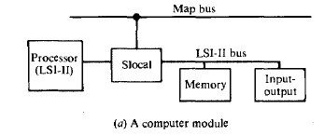
Cm* Architecture
Eg of a Loosely coupled s/m -> Cm*
Each computer module of Cm* includes a local switch called Slocal
Slocal intercepts and routes processor’s requests to the memory & I/O devices

Slide 12
Cluster of computer modules
A no. of computer modules may be connected to map bus so that they share the use of a single Kmap
Kmap is a processor that helps in mapping addresses and routing data b/w Slocals
Cluster is made up of computer modules, Kmap & map bus

Slide 13
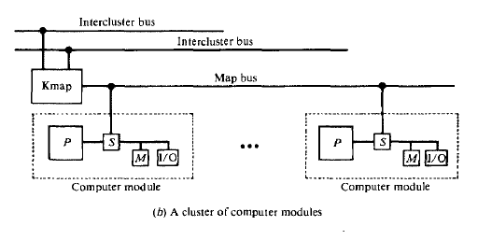

Slide 14
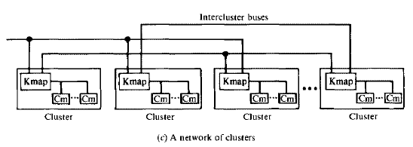

Slide 15
Cm* Architecture -> Kmap
Kmap is a micro programmed, 150-ns cycle, three-processor complex with a data memory
Kmap provides address mapping, communication & synchronization functions within the s/m
Data memory is used to cache address translation tables & mechanisms for synchronization and other resource management functions

Slide 16
3 processors in Kmap are Kbus, Linc, Pmap
Kbus arbitrates requests to map bus
Linc manages communication b/w the Kmap and other Kmap
Pmap is a mapping processor which responds to requests from Kbus & Linc
Pmap performs request processing

Slide 17
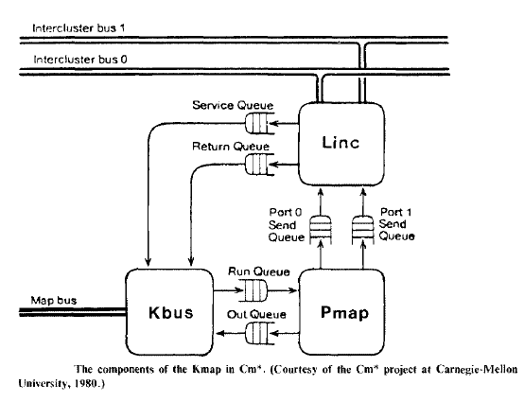
Kmap

Slide 18
3 sets of queues provide interfaces b/w Kbus, Linc & Pmap
Since Kmap is much faster, its multiprogrammed to handle up to 8 concurrent requests
Each of the 8 partitions is called a context & exists in Pmap
Each context processes one transaction
If one context needs to wait for a msg pkt to return with reply, Pmap switches to another context that is ready to run so that some other transaction can proceed concurrently

Slide 19
Kmap operation
1. A service request is signaled to Kbus whenever a Computer module(Cm) makes a non-local memory access
Such a Cm is known as Master Cm
2. In response to service request,
Kbus allocates a Pmap context & fetches the virtual address of the requested non-local memory via map bus
3. Virtual address is placed in Pmap run queue

Slide 20
4. Pmap context performs virtual to physical address translation via a micro subroutine
5. Physical address of requested non-local memory is loaded into Kbus out queue
6. Kmap services the out requests by sending physical address via map bus to destination Cm
7. When destination Cm completes memory access, it signals a return request to the Kmap,
8. which fetches the result of memory access via map bus & reactivates the request context

Slide 21
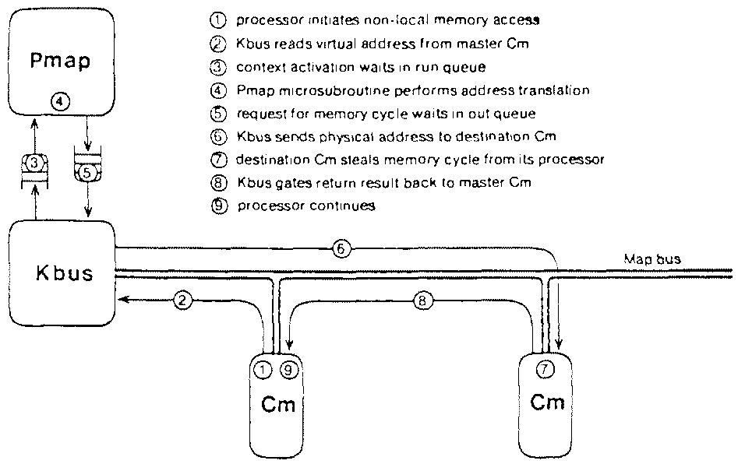
Steps in an Intracluster memory access

Slide 22
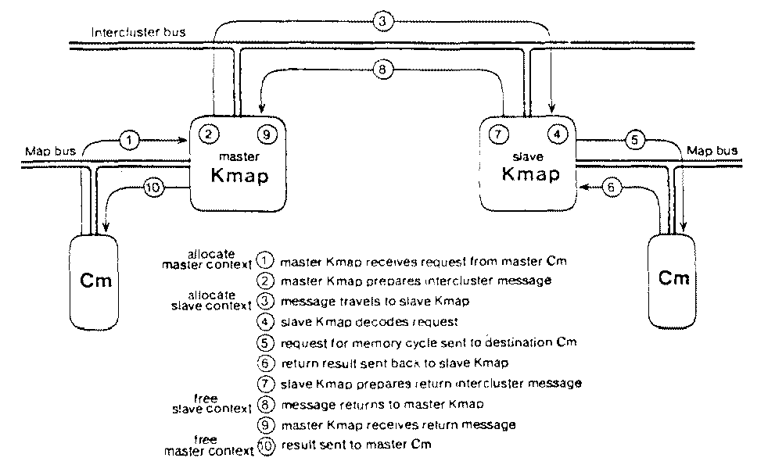
Steps in an Crosscluster memory access

